Slide 1
GSRM Meta-Model: project summary and demo
Gary Doucet
Head of Delegation, Canada
12th UN/CEFACT Plenary
Geneva, May 22-24, 2006
Notes:
As Head of the Canadian Delegation it gives me great pleasure to use this opportunity to contribute to the discussion at the 12th UN/CEFACT Plenary and to provide some background information that the delegates may find useful in discussing the UN/CEFACT standards program and agenda item #6 in particular.

Slide 2
UN/CEFACT Agenda Item #6
Canada supports the idea that the UN/CEFACT program of standards-setting, and associated services, can support both the privates and public sector.
The following slides summarize our experience to use the UN/CEFACT meta-model (UMM) for e-commerce to develop a meta-model for the business of government (GSRM Meta-Model).
Our objective is to inform the Plenary and to contribute to consensus development on agenda item #6.
Our experience to date is very positive and we invite feedback from this Plenary on whether this approach could lead to standards that support both the public and private sectors.
Notes:
In reporting our experience, we wish to inform the discussion. However, no one should conclude that there is an established plan or program of work in the Government of Canada to move the draft meta-model for the business of government to the international standards arena.

Slide 3
Objective
Highlight project objectives, scope, deliverables and timelines
Identify GSRM and UMM synergies
Represent GSRM concepts as UML/UMM constructs
Use BTEP project examples to produce GSRM compliant models
Show some modeling tool screens and features
Summarize results
Identify possible next steps
Questions and discussions
Notes:
This presentation gives a quick overview of a project that was undertaken to demonstrate that existing Governments of Canada Strategic Reference Models (GSRM) can be made more precise by:
using the Unified Modeling Language (UML),
aligning with electronic business modeling conventions (UMM) created by UN/CEFACT and,
extending the GSRM models to support inter-system interactions by defining logical data and process transactions.
We did this by developing a meta-model for the business of government (GSRM Meta-Model) by using the 1st working draft of the UN/CEFACT Meta-Model as our guide.

Slide 4
Project Objectives
Create a formal Meta-Model for the Government Strategic Reference Model (GSRM)
Prepare a set of worksheets to assist service experts and modellers to use GSRM
Develop a UMM compliant modeling tool to model government applications and service
Notes:
The GoC needs a meta-model for GSRM to provide the means to specify what information must be included in a model and to indicate the precision with which that information is to be specified. A GSRM MM will impose additional rigor (i.e. constraints) on the models that are created for GoC services.
The worksheets enable government service providers and managers to use plain text in recording their process and data requirements. These worksheets name and describe specific characteristics about the data and processes that are to be used in designing, providing and managing government services.
Commercial modeling tools are available to create UML models but they are insufficient to support either UMM for electronic commerce nor GSRM for the business of government. To overcome this shortcoming, in commercial modeling tools, the project consultants undertook to extend a UML/UMM modeling tool to expedite GSRM MM development and documentation.

Slide 5
Source Documents
BTEP Practitioners Handbook
UN/CEFACT’S Modeling Methodology Version 1.0 - (1st Working Draft)
Canadian Service Description Mark-up Language (CSDML)
Government Strategic Reference Model (GSRM) Iteration 2
Service Reference Patterns for GSRM
ISO 15944-4 Resource, Event, Agent (REA)
BTEP Transition Design for Small Business Start-up
Notes:
Here is the list of source documents that were used to create the GSRM meta-model. The Practitioners Handbook was the primary guide for modeling the business of government. Concepts and procedures in the Handbook were mapped to counterparts in UMM to the extent possible – as UMM provides the best available example of how to specialize the UML to support the needs of a community of practice (i.e. electronic commerce).
The next three references provided a lot of detail on the fundamental concepts in GSRM – program, service, process and resource. They included various levels of detail, demonstrated some inconsistencies and provided a rich source of inter-relationships that had to be abstracted and and represented in UML/UMM.
The ISO specification provided a framework for thinking about the GSRM concept of “Resource” and its mapping to events and automated processes or business partners. It helped the project team to encourage UN/CEFACT to expedite development of REA as a UMM Specialization.
Small Business Start-up provided sample data and processes that were used to illustrate the use of the meta-model to create a sample model for a government application.

Slide 6
Project Timelines
Work initiated – Jan. 9th, 2006
1st draft of business domain view – Jan. 14
1st draft of business requirements view – Feb. 17
1st draft of business transaction view – Mar. 3
Distributed to UN/CEFACT working groups on techniques of modeling and e-govt – Mar. 4
GSRM MM presented at UN/CEFACT 8th Forum – Mar 13-17
Prototype GSRM modeling tool released – Mar. 31^{th (and ongoing)}
Small business start-up examples developed - Mar. 28th
Sample worksheets generated - Mar. 31st
Draft of GSRM MM User Guide provided – Mar. 31st
Notes:
For those that may be interested this slide highlights project milestones and activities. What is pleasantly surprising is the amount of work that was accomplished in the space of 3 months. A lot of that work was done in the evenings and week-ends but the project was completed on time and also contributed to the development of the 2nd working draft of the UMM which was released on March 17th.

Slide 7
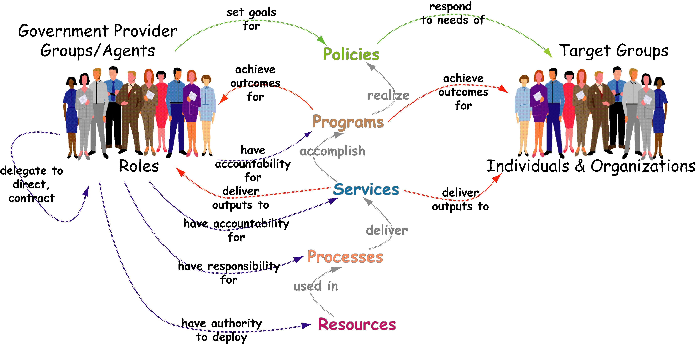
GSRM - Common Language and Structure
For the Business of Government
Notes:
This slide provides a graphic representation of the Governments of Canada Strategic Reference Models (GSRM). Please note that the recent addition of the “Policy” construct meant that we had to rely on more recent information to guide its incorporation into the GSRM MM. This refinement of the GSRM model also required that the “primary” relationship be specified between needs, outcomes, service outputs and process outputs instead of the “former” focus on the associations between policy, program, service, process and resource.
These associations between the various GSRM concepts are illustrated in slide 17 – GSRM – Business Domain View. This slide sets the context for modeling the business of government and highlights the essential concepts that had to be added to the UMM.

Slide 8
e-Government vs e-Business
e-Government (GSRM) | UMM | e-Business (ebXML – SOA)
Policy | Stakeholders CCTS Contexts for: official constraints, etc. UMM Business Area
Program (PSAM) | UMM Process Area
Service (SIAM) | Business Collaboration Realization | CPPA - WSDL
Process | Business Collaboration Use Case Business Transaction Use Case | BPSS - BPEL
Resource | Business Information Entity UML Profile for CCTS | Core Component Technical Specification (CCTS) CCTS Data Library
Notes:
A strong case can be made for creating an integrated model for the business of government and that of e-business since governments set the policies and regulations that govern e-business. Furthermore government agencies conduct business transactions and could do so more efficiently by using e-business standards.
This slide was developed to highlight the concepts that GSRM uses to model the business of government and the corresponding UMM modeling specifications that are being developed by the UN/CEFACT Techniques and Modeling Group.
The right hand column illustrates some standards that can be used to implement the e-government models using applicable electronic business XML (ebXML) or Service Oriented Application (SOA) standards.

Slide 9
GSRM BTEP
Transformation Blueprint
Transformation
Roadmap
What
How
Where
Who
When
Why
Things important to the business
Programs
Services
Jurisdictions
Business locations
Geographical areas
Target Groups
Roles
Parties
Communities
Organizations
Workforce
Cycles
Events
Vision
Authorities
Needs, Targeted needs
Value statements
Outcomes
Environment things
Strategic Design & Planning Deliverables
Business Problem Assessment
Target Business Vision
Transformation Strategy
Target Business Design
Transformation Business Case
Transformation Master Plan
System Design & Planning Deliverables
e.g. as defined by RUP (Rational Unified Process) or UMM (UNCEFACT Modelling Methodology)
Scope & Context
Information
Model
Program Service Alignment Model
Service Integration & Alignment Model
Operations Model
Service level agreements
Logistics Model
Target Group Model
Community Model
Organization Responsibility Model
Culture Model
Events & Cycles Model
Target Group State Transition Model
Authorities Model
Performance Model
Conceptual
Logical data model
Application architecture
Use Cases
Distribution architecture
(Z - distributed system architecture)
Human interface architecture
Processing structure
Business rule model
Logical
Physical data model
System design
System architecture
Presentation architecture
Control structure
Rule design
Physical
Data definition
Program
Network architecture
Security architecture
Timing
definition
Rule specification
Implementation
Operational
Service requests
Service outputs
Process inputs
Process outputs
Service instances
Process instances
Physical locations
Channels
Service recipients
Workers
Service suppliers
Schedule
Performance actuals
Operating Plans
Operations Blueprint
Notes:
This slide illustrates the models that fall under the GSRM umbrella – these are illustrated by the two top rows shown in light blue. The right most column represents the modeling methodology that is used by BTEP to facilitate transformation of government services. The Small Business Start-up report used to illustrate the application of the GSRM MM was produced using the BTEP methodology.
The primary purpose of this slide is to serve as the means of illustrate the relative scope and context of GSRM and UMM specifications – see slide 10.

Slide 10
GSRM Models - Design Elements
WHAT
HOW
WHERE
WHO
WHEN
WHY
(ROW 1: PROGRAM STRATEGIC PLANNER SCOPE/CONTEXT)
Programs
Resources
Jurisdictions
Parties
Events &
Cycles
Needs
Roles
Goals
Services
Locations
Target
Groups
Strategies
(ROW 2: PROGRAM OWNER/CONCEPTUAL MODEL)
Schedules
Semantic
Model
Processes
Logistics
Models
Workflows
Performance
Metrics
Scenarios
Notes:
This slide illustrates some of the GSRM design elements that are needed to model the business of government. Some of these are awaiting further development and refinement.
For this presentation, it is sufficient to note that GSRM MM includes provisions for all of them with the possible exception of location. Part of the reason for this is that the source documents didn’t provide much guidance on how these elements are to be modeled. In addition, concepts such as location type, event type, resource type are awaiting definition in the REA Specialization of UMM.
GSRM MM makes no provision for row 2 models for logistics or for performance metrics due to the previously stated reasons. Had there been enough time it is conceivable that the performance metrics in the Service Reference Patterns for GSRM could have been analyzed and included.
GSRM workflow is accommodated by the UMM choreography view.

Slide 11
UMM Superimposed on GSRM/BTEP
Transformation Blueprint
Transformation
Roadmap
What
How
Where
Who
When
Why
Things important to the business
Programs
Services
Jurisdictions
Business locations
Geographical areas
Target Groups
Roles
Parties
Communities
Organizations
Workforce
Cycles
Events
Vision
Authorities
Needs, Targeted needs
Value statements
Outcomes
Environment things
Strategic Design & Planning Deliverables
Business Problem Assessment
Target Business Vision
Transformation Strategy
Target Business Design
Transformation Business Case
Transformation Master Plan
System Design & Planning Deliverables
e.g. as defined by RUP (Rational Unified Process) or UMM (UNCEFACT Modelling Methodology)
Scope & Context
BDV
Information
Model
Program Service Alignment Model
Service Integration & Alignment Model
Operations Model
Service level agreements
Logistics Model
Target Group Model
Community Model
Organization Responsibility Model
Culture Model
Events & Cycles Model
Target Group State Transition Model
Authorities Model
Performance Model
Conceptual
BRV
Logical data model
Application architecture
Use Cases
Distribution architecture
(Z - distributed system architecture)
Human interface architecture
Processing structure
Business rule model
Logical
BTV
BSI
Physical data model
System design
System architecture
Presentation architecture
Control structure
Rule design
Physical
BSV
Impl’n
Dep’t)
Data definition
Program
Network architecture
Security architecture
Timing
definition
Rule specification
Implementation
Operational
Service requests
Service outputs
Process inputs
Process outputs
Service instances
Process instances
Physical locations
Channels
Service recipients
Workers
Service suppliers
Schedule
Performance actuals
Operating Plans
Operations Blueprint
Notes:
This slides helps to illustrate that the UMM views for business domain, business requirements and business transactions map to row 1 thru 3 of the GSRM Transformation Framework (a.k.a the Zachman Framework).
That little circle in the middle, labelled BSI, stands for business systems interface. This concept was identified in ebXML (electronic business XML), years ago, but never developed by UMM because it encroaches on defining technology specific standards that were deemed outside the scope of UMM (e.g. XML schemas for data and processes). Although the BSI was never formally specified, recent research has demonstrated that a UMM model can be mapped to Web Services Description Language (WSDL) and Business Process Execution Language (BPEL) or Collaborative Protocol Profile and Agreements (CPPA) and Business Process Specification Schema (BPSS) to provide implementation specifications that can be implemented. XML Name and Design Rules have also been developed by the UN/CEFACT Application Technology Group to provide technology specific guidance. The end result is that we can use UMM and GSRM models to create row 4 (i.e. XML schema) and row 5 specifications (i.e. BPSS and BPEL).
Thus it could be argued that UMM and more importantly the GSRM MM provides Government of Canada (GoC) with the bases on which to specify row 4 and row 5 specifications for use in implementing GoC applications at the departmental and cross-departmental levels..

Slide 12
Small Business Start-up (SMS)
Cross-jurisdictional project undertaken by CIOB, IC, COBSC and Halton region to demonstrate use of BTEP for harmonizing and enhancing govt services
3.5 months effort completed in Feb. 2004
Report used to create GSRM MM examples
SMS specifications enriched by data from follow-on project - BizPal website
Next few slides discuss sample data used to create GSRM MM examples
Notes:
The Small Business Start-Up (SMS) project is an interesting application of the BTEP methodology in that it involved 3 levels of government or jurisdictions. It also provided sample BTEP deliverables that were related to UML constructs and modelled using the prototype GSRM MM modeling tool.
The SMS project, like others of its kind, is a visioning and strategy setting exercise that identifies models that need to be created. It is a good starting point but the BTEP methodology is not designed to provide the detailed information that is needed to create logical models for data and processes to enable application design and implementation. Furthermore, BTEP is optimized to facilitate the transformation of government services and as such focuses on processes to be used in satisfying target group needs. In other words, the BTEP methodology does not provide the underlying process and data models that are a pre-requisite to application design – these details are implicit in BTEP reports and must be elaborated by more specific designs.
The following slides illustrate sample SBS reports, to demonstrate how this information was used to create GSRM MM examples – which include supplementary details that were deduced or obtained from alternate sources (i.e the BizPal website).

Slide 13
BTEP - Opportunity Identification Deliverables
Deliverable | Description
Problem Statement | Problem statement addressing services to designated target groups, including the definition of client intent, client needs, and gaps to be recognized in the transformation opportunity
Vision Statement | Vision for transformation of services to these target groups based on existing higher-level service visions.
Opportunity Identification | Identification of opportunities for transformation projects and recommendations for next steps, including justification for proceeding.
Business Design | A strategic business design containing a model of the integrated services to be offered to these target groups, addressing recognized needs and intent. The business design is represented by a series of models of current and future business definitions and operations.
Strategy Statement | Strategy for realizing this initial vision
Notes:
This slide illustrates the strength and contribution that BTEP makes to context setting (i.e. provides details for the business domain view). Any potential collaborative effort must determine the business opportunity. This “opportunity” statement effectively sets the initial parameters of the business of government that will be modelled.
Context is a fuzzy concept that can be specified using a wide range of views or starting points. However, it is critical in establishing the scope for a modeling project. In addition it provides the main avenue for discovering re-usable e-government and/or e-business data and process models.
The next two slides illustrate the “context” that was established for the Small Business Start-up project and how contexts are specified in the GSRM Top Model (i.e. government specific classification schemes) and represented in the GSRM MM.

Slide 14
Opportunity Statement: Enhance COBSC Services
Opportunity Name | Identify a name that describes the opportunity. -enhance COBSC collaborative role
Opportunity Scope | Provide a description of the scope of the opportunity.. -expand on existing collaborations in the area of municipal services, e.g. Halton
Current Scenario | Describe the current business scenario within the opportunity scope. -COBSC services stop at Federal and Provincial levels
Current Problems | Identify the current problems. Use Output Transition Bundle to identify the related problems. -provide information on only half services provided by government to meet the needs of new business start ups
New Scenario | Describe the new business scenario and how the service outputs will facilitate the transition from one state to another. -COBSC will address Federal, Provincial, Regional and Municipal services
What is changed | Identify the changes. (e.g. consolidated services, modified outputs, a new service or changed cycle). -regional and municipal services will be included
What is better | Focus on the outcome or value that is provided to the service recipient and to another service. -one stop shop for integrated referral to services
Notes:
The Small Business Start-up (SBS) project concluded that priority should be given to enhancing two cross-jurisdictional services. This slide identifies one of those opportunities. Having identified the “Service” to be modeled, we need to specify the “program” and “policy” under which this service is or will be provided. In this case, COBSC is a joint federal provincial program, which according to the opportunity statement will be expanded to cover “regional” service providers.
Using the above project deliverable, we need to insert the “opportunity scope” in the GSRM MM stereotype for “service”, the “new scenario” definition is used to describe a GSRM MM stereotype for “business process” and “what is better” will describe one or more “outcome” to be realized by an enhanced COBSC “program”.
The information gathered in the BTEP process provides the means to “understand the business under consideration”. The information that is gathered using the BTEP methodology and the information included in the UMM business domain view are well aligned with respect to purpose - but the details that are captured can be different.

Slide 15
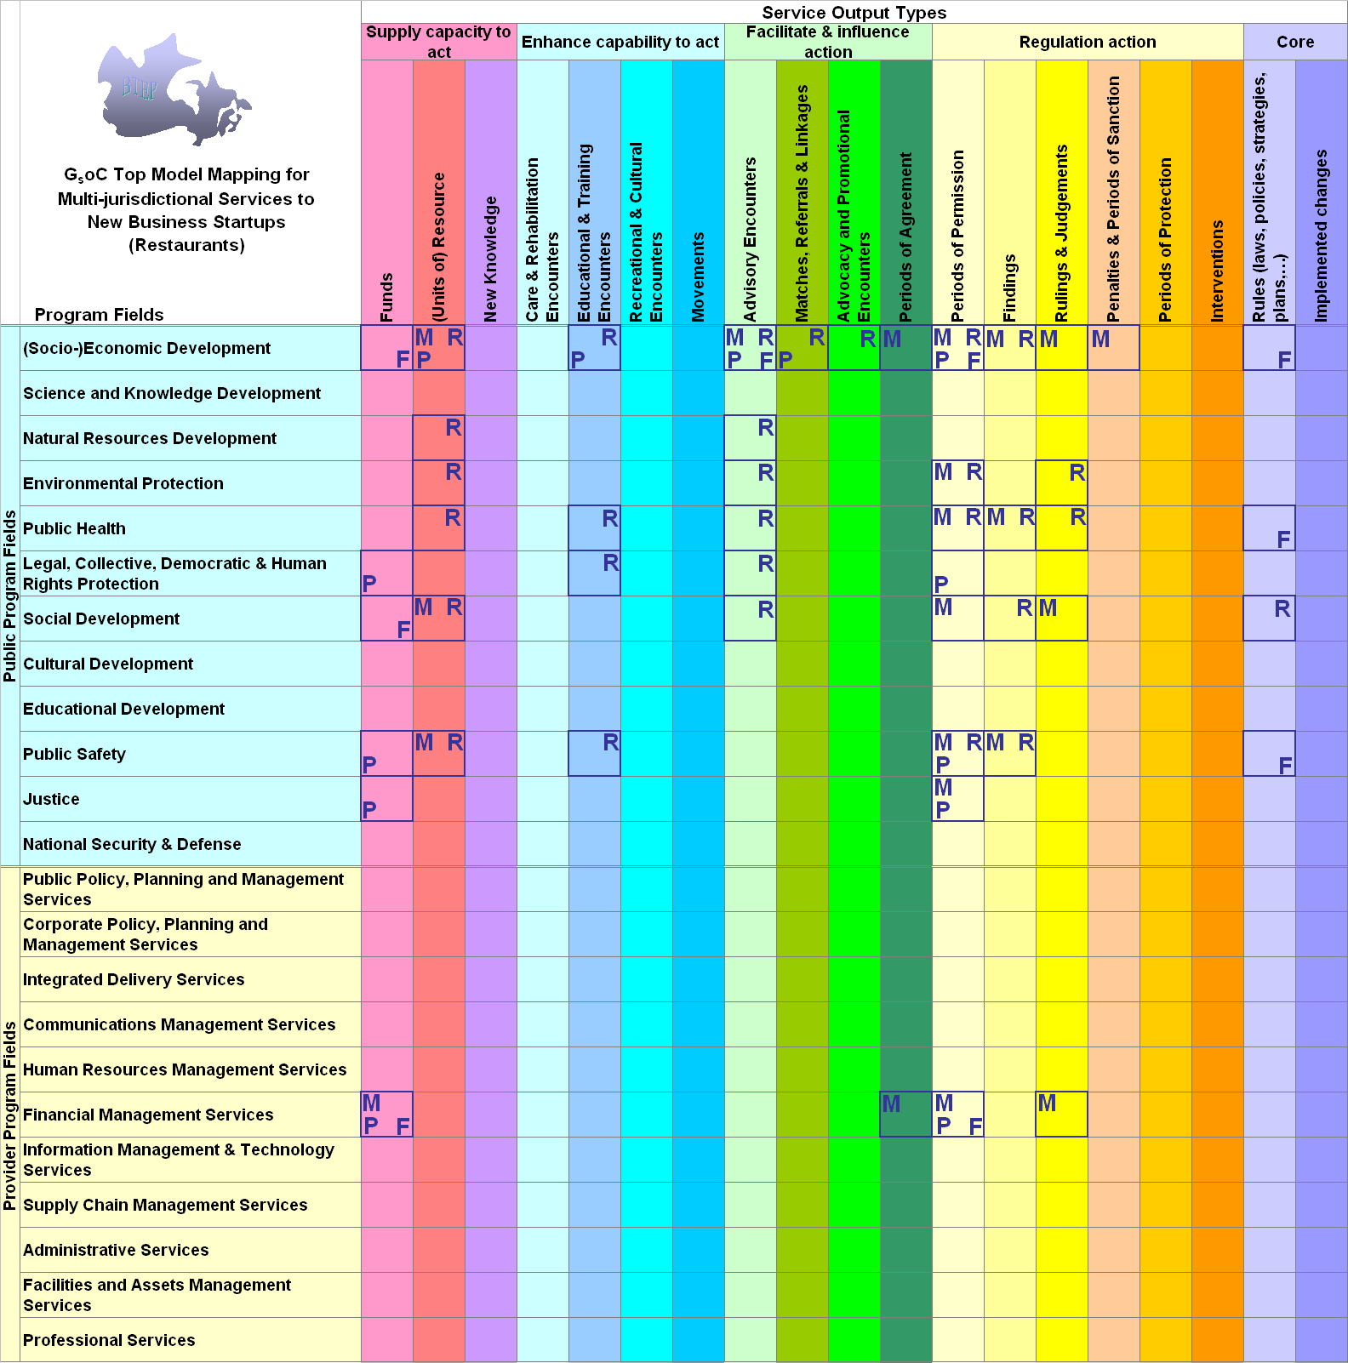
GSRM Top Model - services for restaurant start-ups
Govt service output types are columns
Needs are rows
Letters indicate govt service outputs supplied by specific jurisdictions to meet client need on that row (M=Municipal R=/Regional, P=Provincial, F=Federal)
Click here to open the spreadsheet
Notes:
The GSRM Top Model is the mechanism for establishing the context for government services and for classifying all the GSRM models. The rows in GSRM Top Model are a government counterpart for the UMM Business Areas and the columns are the corresponding elaboration of UMM Process Areas. The Common Business Process Catalogue provides an example of a recommended UMM classification scheme for the international supply chain.
Every Program modelled using the GSRM MM must specify the Business Area (I.e. the GSRM Program Field) to which it belongs. Similarly, every Service that is modelled must specify the Process Area (i.e. GSRM Service Output Type). These requirements could be enforced by a GSRM MM modeling tool to ensure that a valid value was provided for each.
In the case to the Small Business Start-up, the Canada Ontario Business Service Centre (i.e. program) was classified as belonging to Socio-Economic Development and the information services provided to business start-ups as an instance of an Advisory Encounter.

Slide 16
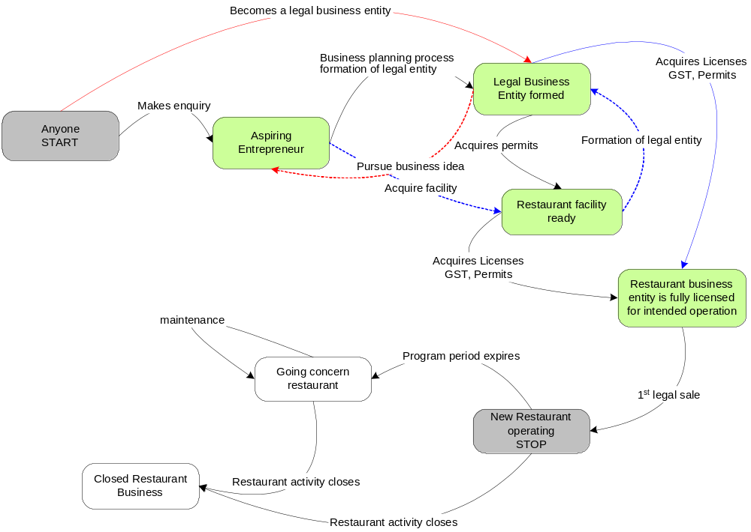
State Transitions - opening a restaurant
Primary states an individual undergoes in opening a restaurant
Multiple paths are possible – predominant path shown in blue
Various services are needed over time to help the entrepreneur make the state transition
Notes:
This slide identifies the states or stages that an individual would traverse in establishing and operating a restaurant. To move an individual from one stage to the next, a variety of pertinent information must be exchanged between that individual and a variety of service providers (i.e. business councillors) at the federal, provincial, regional and municipal levels of government. The GSRM MM provides the means for all of these exchanges and states to be modelled.
Associating a “state” with an individual, who is technically a business partner that is collaborating in a business process, is a modeling convention that is unique to BTEP/GSRM models. It appears that this “state” is actually a change in the participant’s “role”.
The next three slides provides examples of the kind of GSRM models that must be captured,

Slide 17
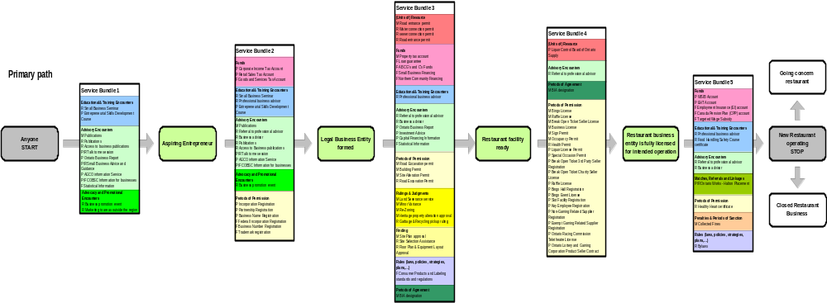
Transition Output Bundles grouped by GSRM Service Output Type (primary path)
Services could be bundled by state transition and service output type to simplify the business start-up tasks for the entrepreneur
Advisory services, required at most transition points, come from multiple jurisdictions
Entrepreneurs don’t know when they need advice, what questions to ask or who to ask and there is no central point of access to the advisory services offer by all jurisdictions
Click here to open vizio diagram
Notes:
This slide illustrates the types of service outputs that need to be provided to support small business start-up – restaurants in this case. The color coding represents outputs of a particular type – advisory encounters are pale green. These outputs can also be classified according to the jurisdiction that is providing the advisory encounter.
Each service output type (i.e. information brochure, case evaluation, etc.) is modeled as a “UMM business entity” in the GSRM MM. These service outputs could be structured documents that may conform to a specific XML schema or interchange format.

Slide 18
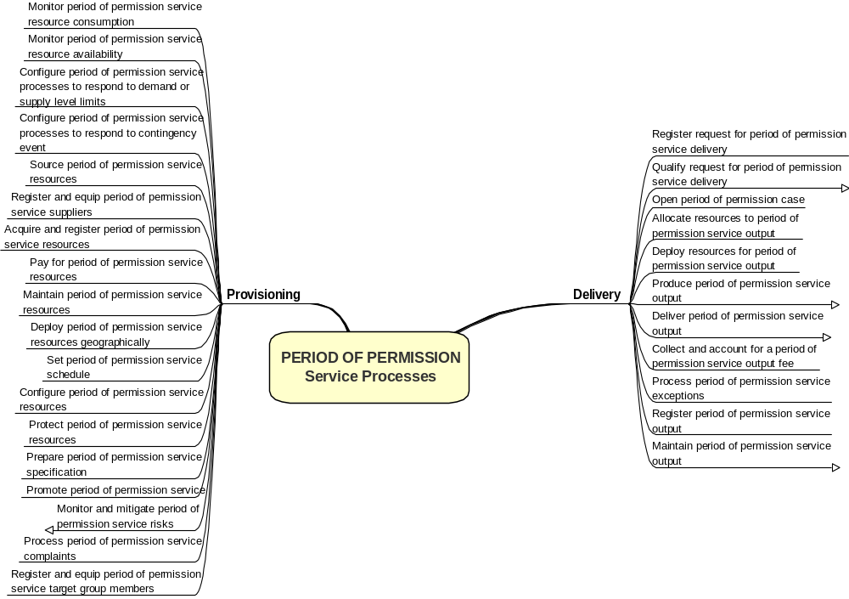
Service Process Pattern Analysis
Service Process Pattern shows the processes used to deliver a specific type of service output
Notes:
The GSRM has defined a set of processes that may be applicable in Service planning, provisioning, delivery or decommissioning – called service process patterns. This slide illustrates the processes that were used in the Small Business Start-up (SBS) project to identify provisioning and delivery services for periods of permission (i.e. licenses - another one of the service output types)
These patterns have been integrated into the GSRM MM and are re-usable for creating the activity graphs for a business process (actually one or more business transaction use cases or business collaboration use cases).
An activity graph partitions these processes into internal and collaborative processes that are executed by two business partners (i.e. the individual versus the Canada Ontario Business Service Centre in the SBS example). The collaborative ones must maintain a shared state in order to control the exchange of messages (i.e. workflow) between business process participants. The resulting activity graph that was created using these delivery service process patterns for an advisory encounter appears in slide 29.

Slide 19
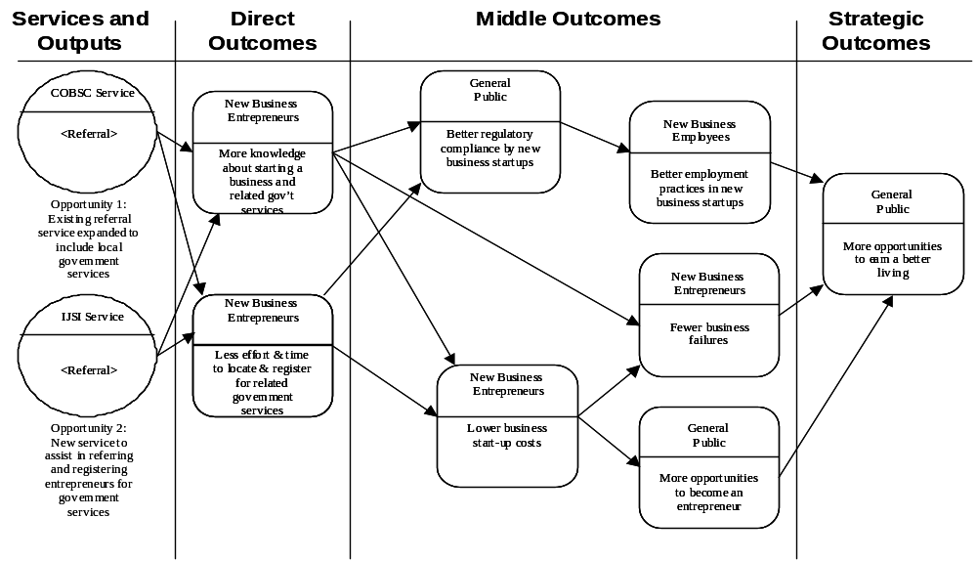
SBS - Program Logic Model
Notes:
The Program Logic Model is one of the core models in GSRM. It is designed to capture the accountability of one service to another. This example, taken from the Small Business Start-up (SB) project, illustrates how service outputs contribute to the realization of program outcomes (i.e. direct, middle and strategic).
The GSRM MM enables service outputs to be associated with the three types of outcomes as part of the modeling process.
It is anticipated that GSRM compliant modeling tools will provide modellers with drop-down lists, at the model design stage, so that each service output could be classified according to outcome type.
This completes the set of SBS project examples and discussion of how business transformation information would be used to create GSRM compliant models with the entire process being supported by a GSRM MM modeling tool.

Slide 20
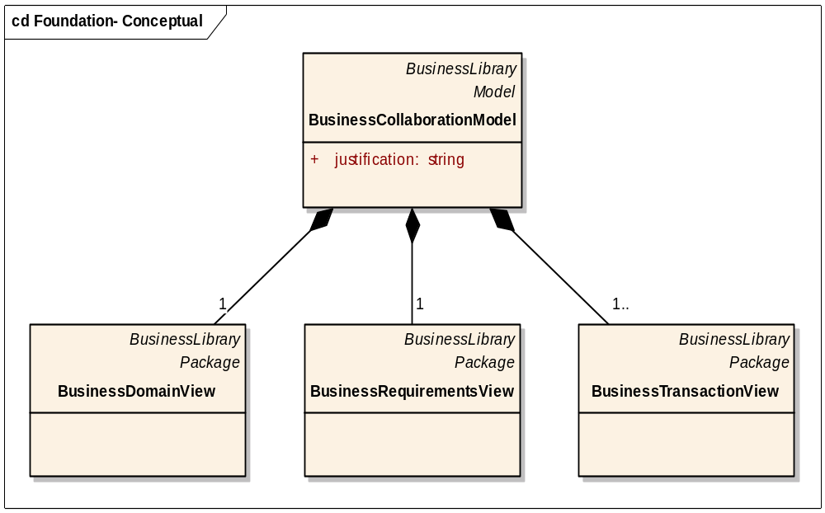
UMM Foundation Module
Notes:
This slide is the first of 7 designed to highlight UMM modeling constructs and the way that GSRM MM maps to them through extensions and replication.
The UMM Foundation Module provides the reference base for future UMM specializations, that will be developed by UN/CEFACT, and extensions such as the GSRM, that are developed by organizations wishing to use the power and rigor provided by UMM.
Using this example, we might want to simplify the model name and views by calling them:
Government Collaboration Model
Government Domain View (GDV)
Government Requirements View (GRV)
Government Transactions View (GTV)

Slide 21
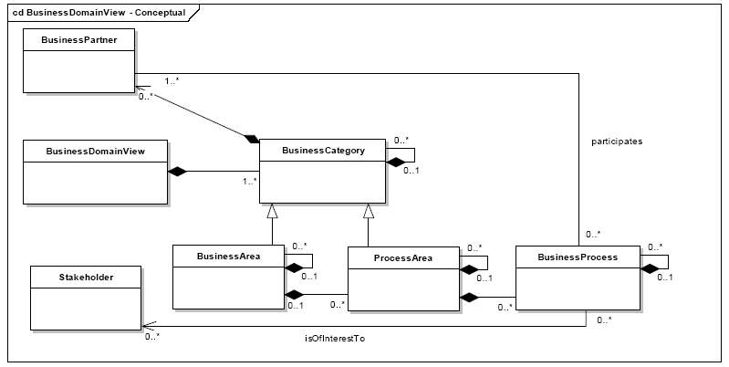
UMM - Business Domain View (BDV)
Notes:
This slide highlights the concepts within the UMM Business Domain View (BDV) and serves as a reference point for the extensions that were made to accommodate concepts related to the business of government domain shown in the next slide

Slide 22
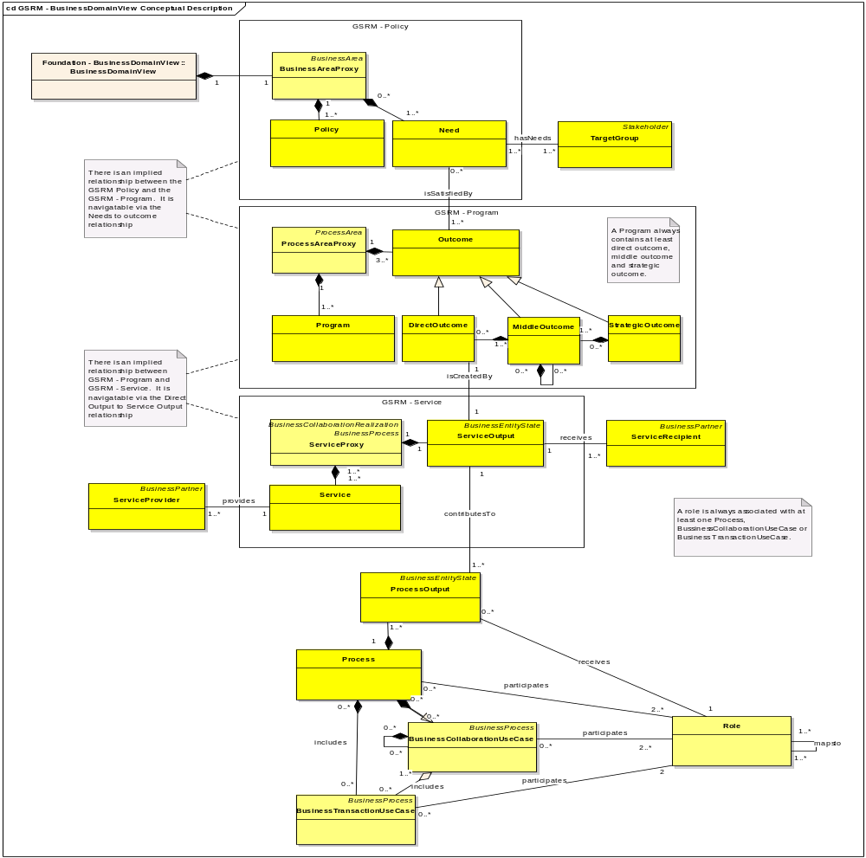
GSRM – Business Domain View (BDV)
Notes:
This slide illustrates key GSRM concepts such as policy, program, service, and process that were used to extend the UMM business domain view. The dark yellow boxes represent concepts that are unique to GSRM. The lighter yellow boxes represent UMM concepts that have been modified or extended somewhat to meet govt needs.
Since the GSRM MM represents the first example of an extension to UMM, our effort received a lot of attention from various UMM working groups that met in mid-March at the 8th UN/CEFACT Forum in Vancouver.
The GSRM MM specification has been very well received and one of the more immediate results was a number of updates to the UMM Foundation to address modeling issues that we identified while preparing the GSRM MM. We plan to circulate the completed GSRM MM document for review and possible use as a reference source for developing a Government Specialization of UMM.

Slide 23
GSRM Concept - UML Stereotype + Tags
Stereotype
ServiceRecipient
Base Class
Actor
Parent
BusinessPartner
Description
A Service Recipient is the party that directly receives or experiences, either willingly or begrudgingly, the output of a service.
Tag Definition
Inherited tagged values:
serviceRecipientName
Type
String
Interest
Multiplicity
1
Description
The name given to the Service Recipient
serviceRecipientDescription
Type
String
Multiplicity
1
Description
A description of the Service Recipient
Notes:
This slide illustrates how GSRM concepts are documented using UML stereotypes and tags. The tag definitions include additional characteristics (i.e. attributes) about each concept.
The Canadian Service Description Mark-up Language (CSDML) has developed a large number of tags to capture information about GSRM concepts such as program, service, etc. We were selective in adding these tags to the MM because there is no harmonized set of characteristics for the GSRM, Provincial Service Reference Model (PSRM)M and Municipal Reference Model (MRM). Furthermore including an exhaustive set of tags in the GSRM MM , at this time, would have done little to demonstrating the main aspects and uses of a meta-model or a GSRM modeling tool.

Slide 24
GSRM Quality Assurance – Object Constraint Language
A hasNeed association MUST always connect a Need and a TargetGroup
package Model_Management
context Association
inv isHasNeedsConnector:
self.isHasNeeds() implies
self.client->one(isNeed()) and
self.supplier->one(isTargetGroup())
self.client->size() == 1 and
self.supplier ->size() == 1
Notes:
This slides illustrates the third feature of a UML model – the object constraint language. An OCL is specified to enable a modeling tool to verify that all the design elements have been included in a given model.
One of the implications is that every model for a government service could be validated before being proposed as a re-usable component. If the GSRM MM became mandatory then all applications for Treasury Board funding could be automatically validated for compliancy to GSRM. This would eliminate all last minute requests for specified government officers to confirm project compliance to GoC Enterprise Architecture requirements! These are only some of the implications - there are many others.

Slide 25
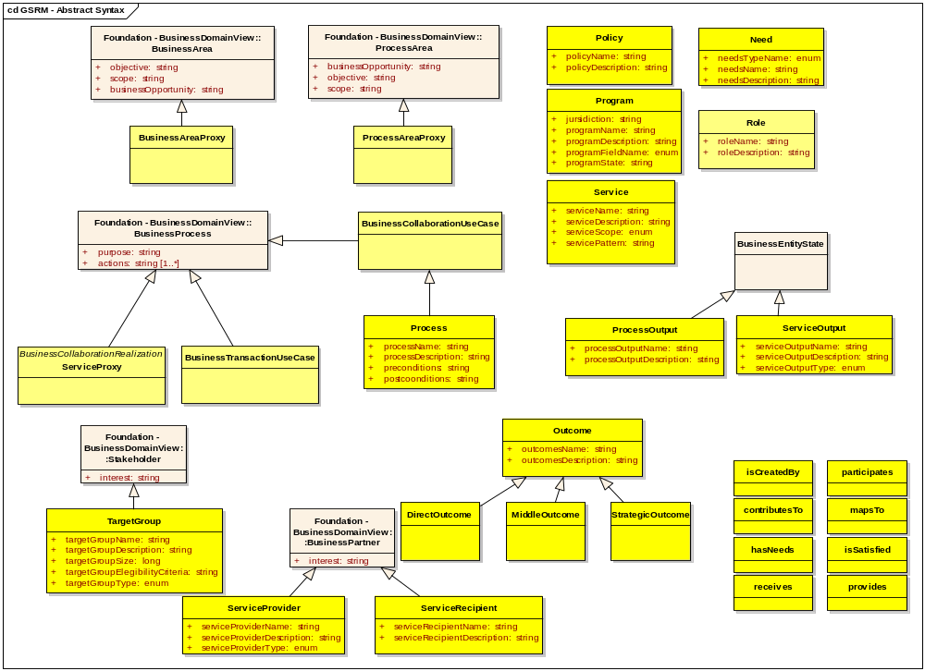
GSRM – BDV Stereotypes + Tags
Notes:
This slide illustrates the normative concepts (objects) in the business domain view. It also specifies the associations that are used to link related concepts, associations such as “isCreatedBy”, “hasNeed” etc., that are required to specify the nature of a relationship between any two objects.
The light coloured boxes represent pure UMM constructs, while the light yellow ones are GSRM modifications to UMM constructs and the dark yellow ones are uniquely GSRM.
Each and every concept is specified using stereotypes and tags. OCL specifies compliance requirements for each concept and association.

Slide 26
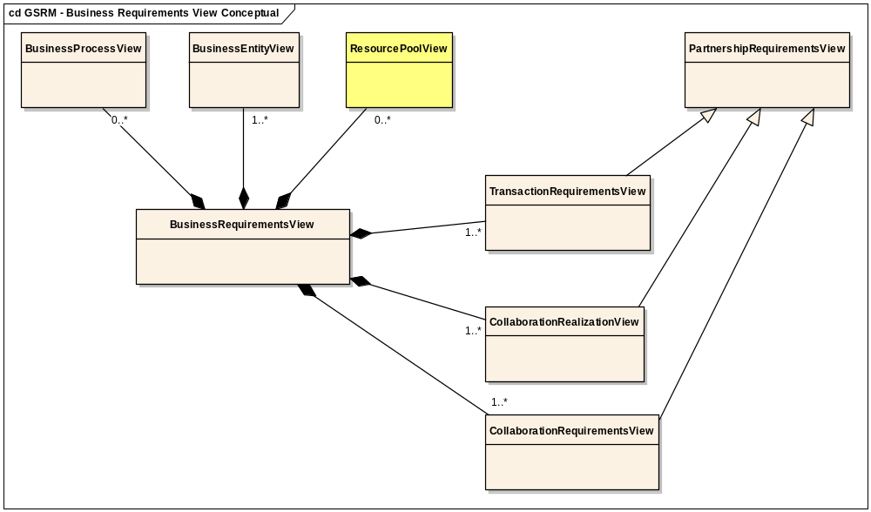
GSRM – Business Requirements View (BRV)
Notes:
This conceptual view of the GSRM BRV highlights that only one new concept is being added to the UMM Business Requirements View – the Resource Pool View. This is where the fifth major concept in GSRM is being inserted into UMM. It is an interesting addition, in that it is a central concept in the yet to be specified REA Specialization of UMM. UMM experts will notice that this figure rearranges the concepts in the UMM BRV to make the relationships more readily apparent.
The Canadian Service Description Mark-up Language (CSDML), spearheaded by the provincial government of Ontario, served as the primary for defining the Resource concept.
“Resource” appears to be a critical modeling construct that may need to be finalized before a performance reference model is added to the GSRM MM. Performance metrics are also an concept that may resurface as a UMM Specialization in due time.

Slide 27
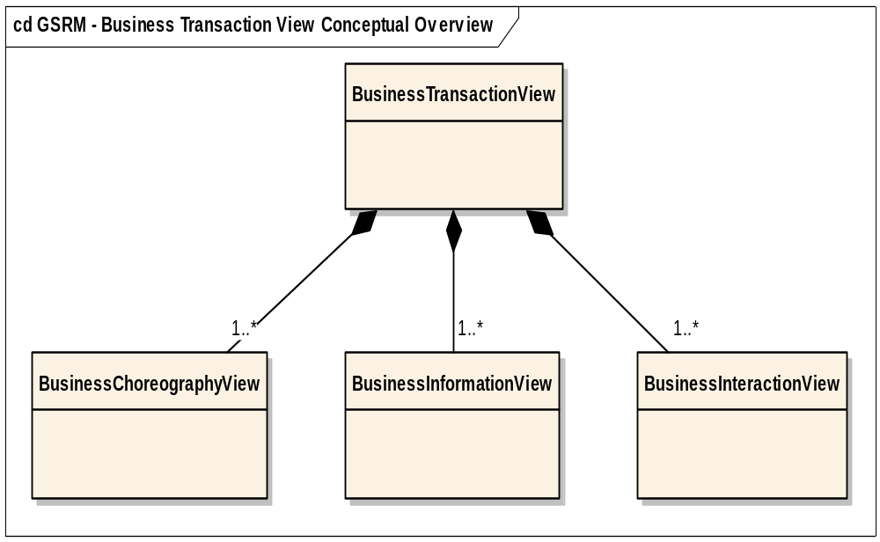
GSRM – Business Transaction View
Notes:
This slide introduces the idea that row 3 of the GSRM Framework (i.e row 3 of the Zachman Framework) can be specified without any extensions to the UMM Business Transaction View (BTV)!
It might be argued that this assertion needs to be validated through actual modeling and implementation projects. However, that would be a waste of time since the business transaction view is application agnostic. It doesn’t care what the messages are or the data that they contain. Each interchange is oriented to maintaining a persistent view of the shared state of a business collaboration. The nature of the collaboration is immaterial.

Slide 28
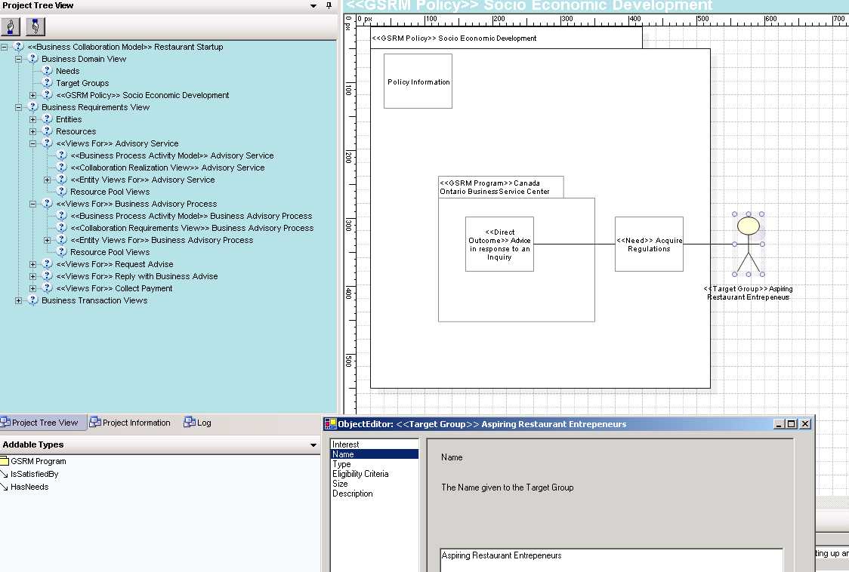
Capturing GSRM Stereotypes + Tag Data
Notes:
This image illustrates a sample screen that is used to record the data for a GSRM concept (i.e. the name, description, parent class, etc of the stereotype) and its characteristics (i.e.the name, description, data type, valid values and multiplicity of each characteristic- tag definition).
Using a GSRM compliant modeling tool, a modeller would be provided with easy access to more detail on any concept included in the top right hand quadrant of this graphic. (e.g. PROGRAM, SERVICE and PROCESS. This includes related concepts such as NEED and TARGET GROUP.
Easy browsing and navigation across views or rows of a model under development is very important for modeller productivity and error resolution.

Slide 29
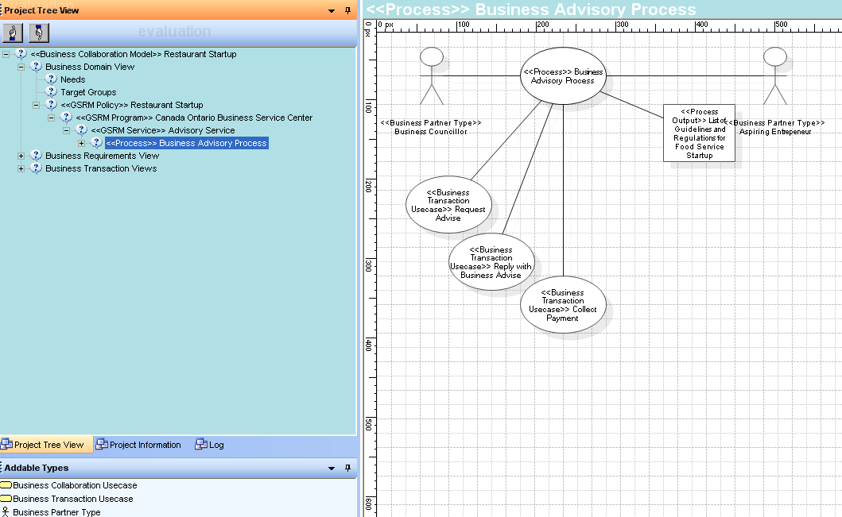
Generating Use Case Diagrams
Notes:
This image shows a sample use case diagram that was created for the Small Business Start-up example. It is not particularly interesting because a static diagram can not show the tasks that are executed to reformat the data that has been captured using the stereotypes for the actors, stakeholders, contexts and tasks that were defined in modeling a government service in the business domain view. Since the graphic is generated, the modeller also doesn’t need to learn the intricacies of some graphics editor.
Other quality assurance and user assistance that is made possible using a GSRM compliant modeling tool, include:
Feedback on missing components when the validation routine is invoked.
Provision of enumerated list of values that apply for a particular concept.
Etc.

Slide 30
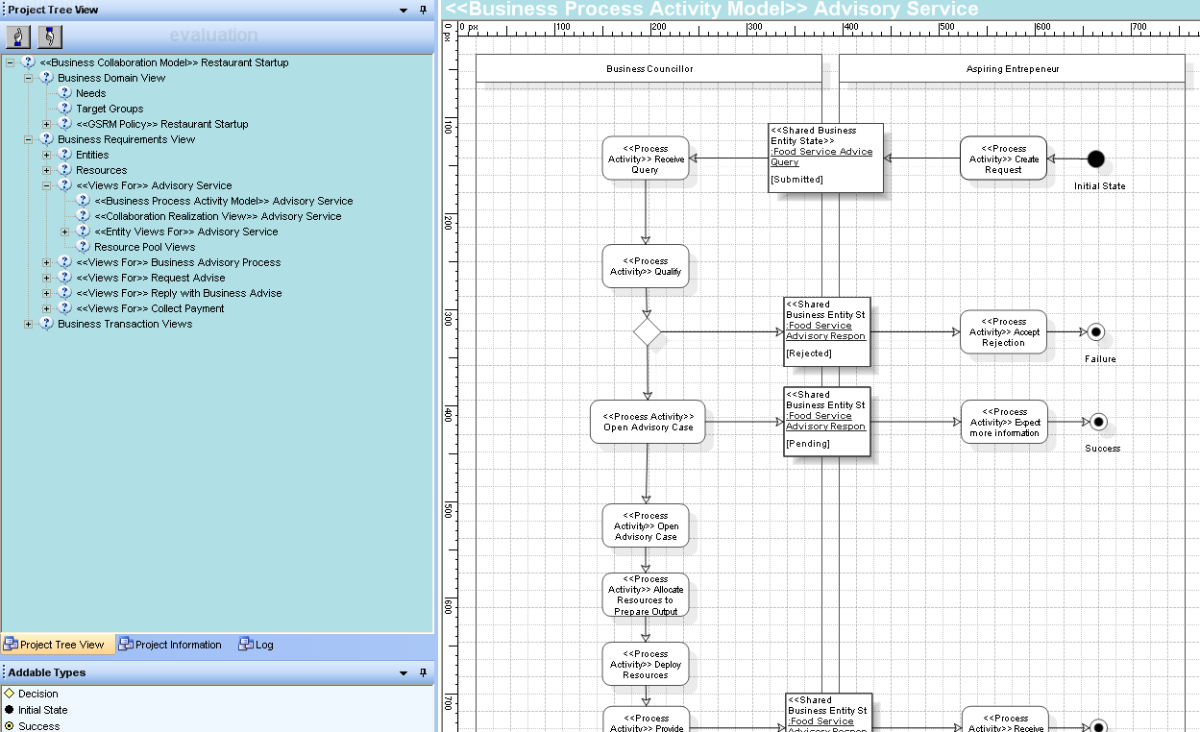
Generating a Activity Graph
Notes:
This image illustrates another modeling artefact that is essential and that is generated using data and tag definitions provided by applicable stereotypes for business domain concepts plus the entity lifecycle for the real world object of interest (i.e. advice on licenses required to open a restaurant) to the process participants.
This particular example comes from the Small Business Start-up project and st interesting because it shows the kind of information that is required to complete the modeling process that was initiated by the BTEP methodology.

Slide 31
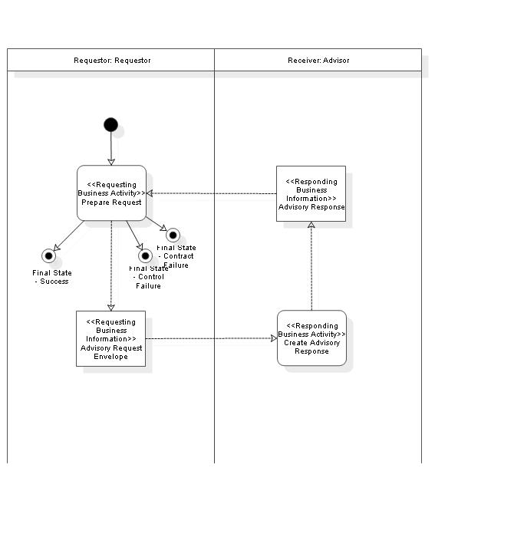
Generating BTV Models
Notes:
This Figure was generated automatically using data captured in the BRV. It can be used in a variety of ways to determine that a model is accurate as envisaged by the UMM.

Slide 32
Modeling Environment
A robust modeling infrastructure will need tools to support standard UML profiles that enable modeling data to be discovered, imported, adapted, contributed and registered, in one or more registries, for re-use by a community of practice
Quality models depend on thorough knowledge of:
  Program objectives and policy constraints
  User requirements and service commitments
  Streamlined processes and accurate information
  A range of skilled staff - managers, analysts, architects, etc.
Meta Model-enabled modeling tools can expedite verification and validation of data and process models for compliance to GSRM
Modeling tools should generate business and technical documentation to ensure that the information in accurate and timely.
Notes:
Meta-Models and modeling tools are essential but insufficient to establish a modeling environment within a community of practice such as the Government of Canada or all the Governments in the world. This slide suggests that we will need a communications infrastructure, some additional technical specifications, skilled individuals, validation services, commonly understood roles and responsibilities, etc.

Slide 33
Conclusions
GSRM can be fully modeled using a specialized Meta Model based on UMM.
Modeling tools can guide business analysts and modellers in creating GSRM complaint models.
Modeling tools can be used to validate models and provide quality assurance.
Modeling tools can re-use GSRM patterns, information objects, classifications schemes, etc.
Modeling tools should be interfaced with registry services to achieve optimal re-use of GSRM artefacts.
Notes:
In conclusion, we hope that we have confirmed the following opportunities.

Slide 34
Possible Next Steps
GoC has been requested be various sources to foster the GSRM MM as a UN/CEFACT standard.
Investigate if the ICCS¹ could become the vehicle through which GSRM MM is processed as a Pan-Canadian standard.
GoC standards program could make GSRM MM compliancy mandatory for new GoC systems design.
GoC may establish a training program for GSRM Modelling and Development.
GSRM MM should support use of ISO 11179, CCTS and some other GoC data libraries.
GoC should establish registry services to manage re-usable data and process models.
1. Institute for Citizen-Centered Services
Notes:
Here are some indications of possible next steps that may materialize and be led by the Government of Canada.
The Institute for Citizen-Centred Services (ICCS), is a newly incorporated agency, with a Board of Directors that is designed to facilitate a variety of horizontal initiatives initiatives across all levels of government, including the creation and deployment of Pan-Canadian standards.
Thank you for your attention and lets open this presentation for questions and discussions.

Slide 35


